Slide 1
TELECOMMUNICATION TESTING

Slide 2
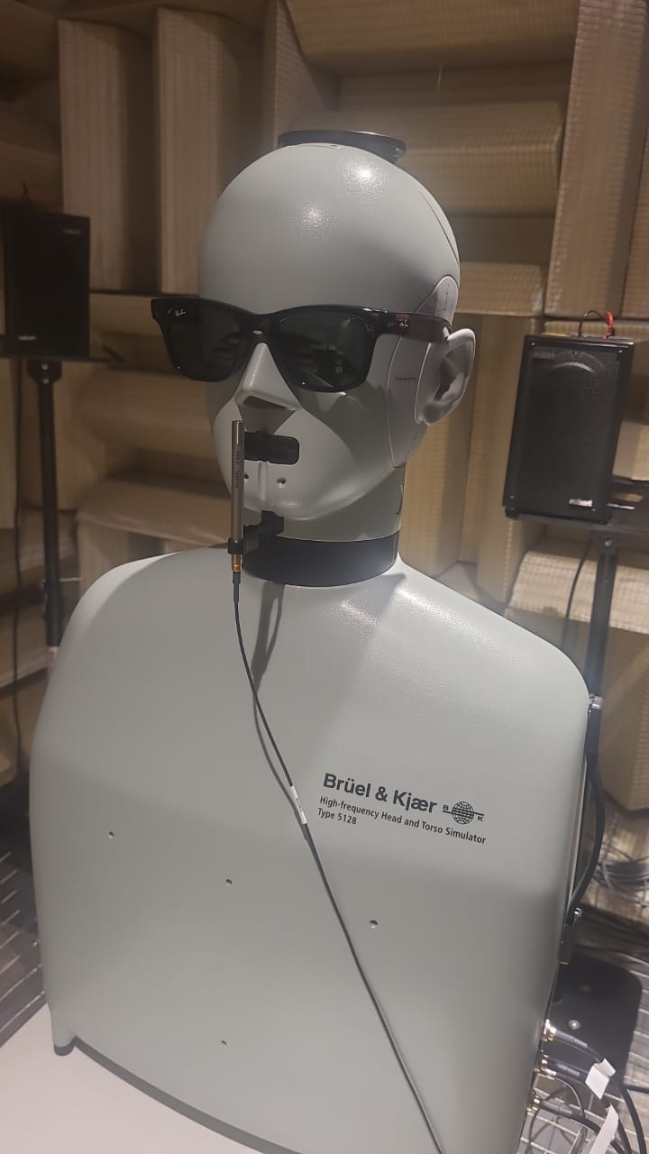
Example : SCM Microphone
Inside Head L,R Microphone
Speaker

Slide 3
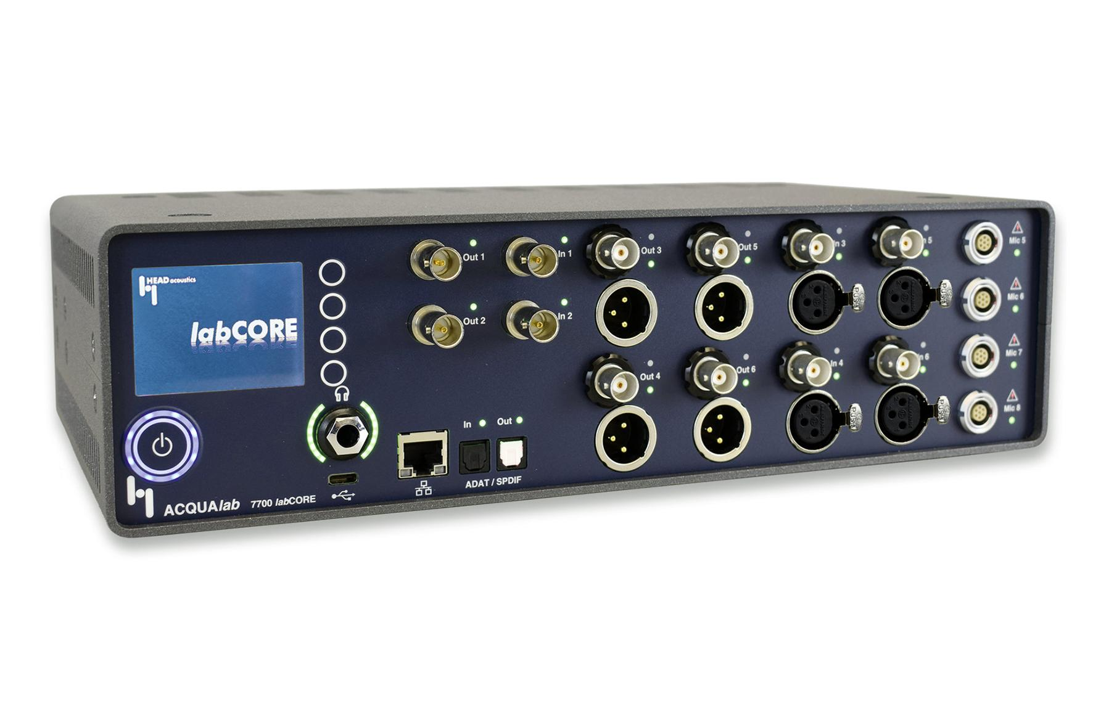

Slide 4
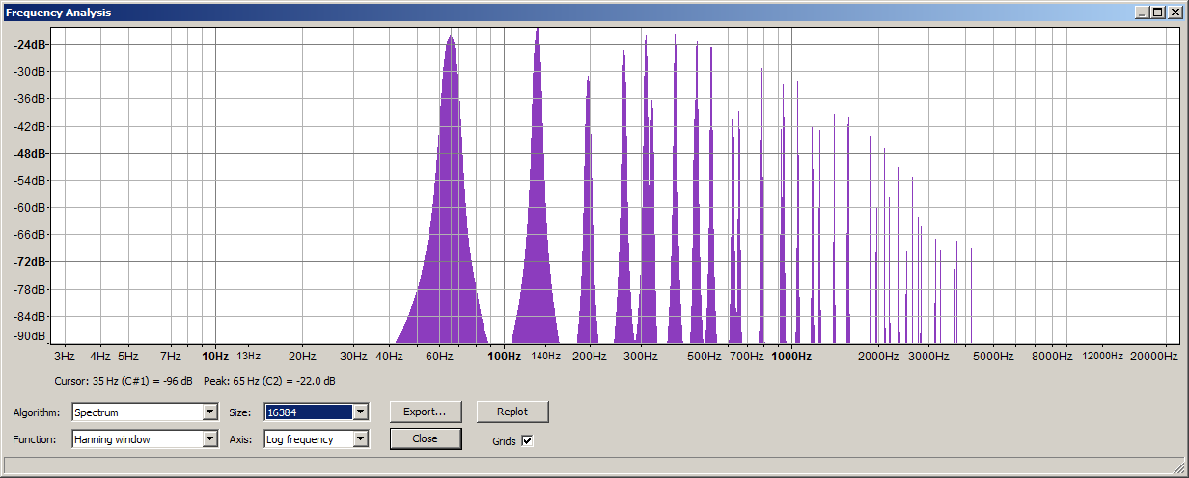
Frequency Response

Slide 5
Send Frequency Response(SFR)
Mouth(Speaker) →Microphone(DUT) →Analyse(Frequency response)
Receive Frequency Response(RFR)
DUT(Speaker) →Microphone(Head Simulator L,R MIC ) →Analyse(Frequency response)

Slide 6
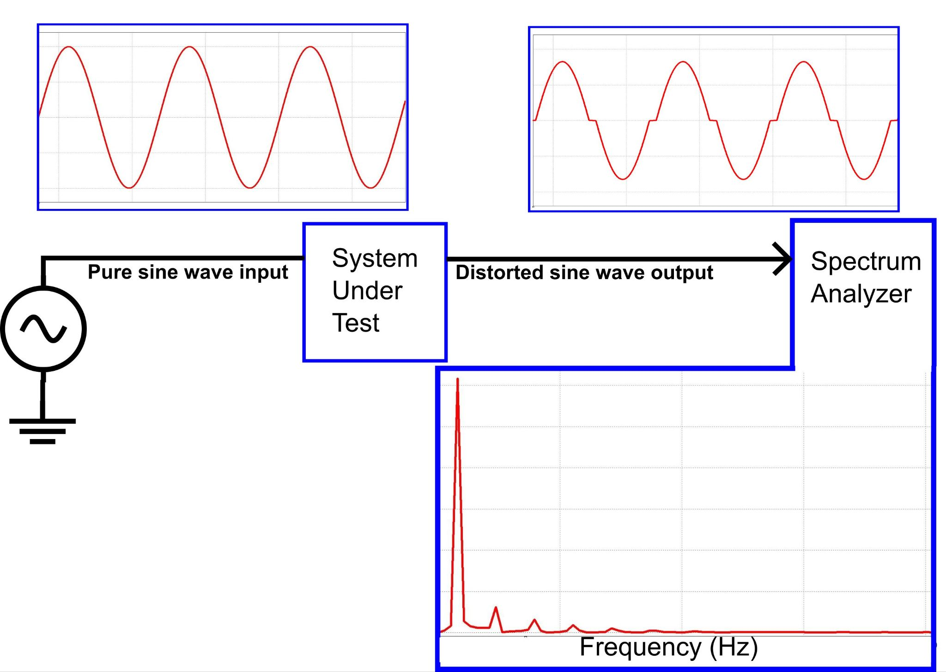
Total Harmonic Distortion(THD)
When a system's waveform is altered by adding higher-frequency signals called harmonics, which are integer multiples of the fundamental frequency

Slide 7
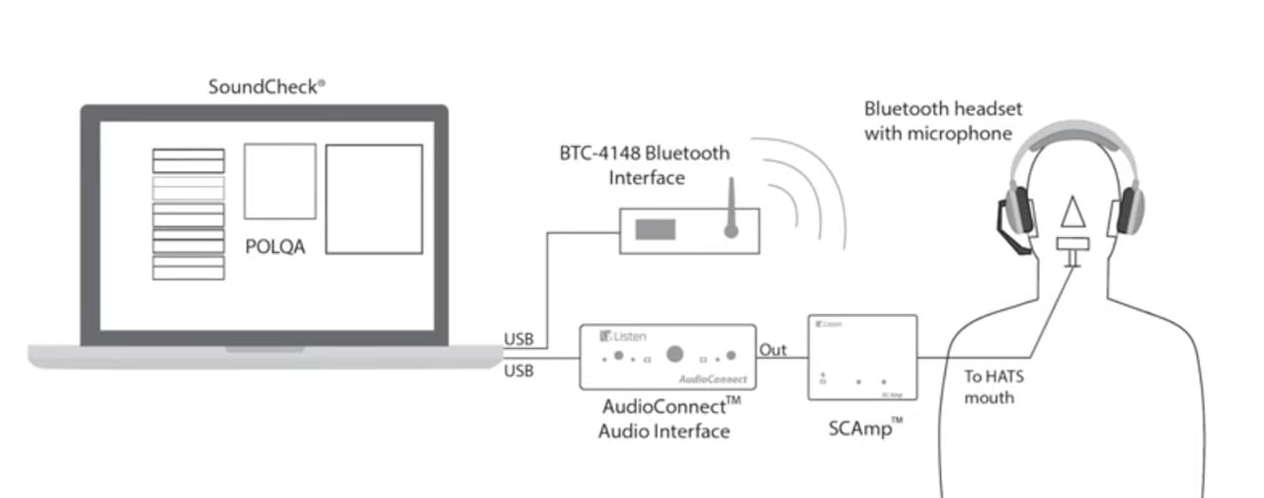
POLQA - Perceptual Objective Listening Quality Analysis
ACQUA →(ACQUA Ref signal-speaker) → headphone(microphone)→ ACQUA(POLQA) →MOS(Mean opinion score)

Slide 8
SLR, RLR
In audio, SLR (Send Loudness Rating) and RLR (Receive Loudness Rating) are
metrics defined by the ITU-T to measure the loudness loss in a telephone connection. SLR measures the loudness loss from a talker's mouth to an electric interface, while RLR measures the loudness loss from that same electric interface to the listener's ear.
ACQUA →(ACQUA Ref signal-speaker) → headphone(microphone)→ SLR(ACQUA)
ACQUA →(SPEAKER) → Head & Torse(microphone)→ RLR(ACQUA)

Slide 9
TCLw - Terminal Coupling loss
It is a measurement how much of received signal leaks into the send signal.
ACQUA(TCLw) →DUT speaker (audio)→Back to DUT Microphone.

Slide 10
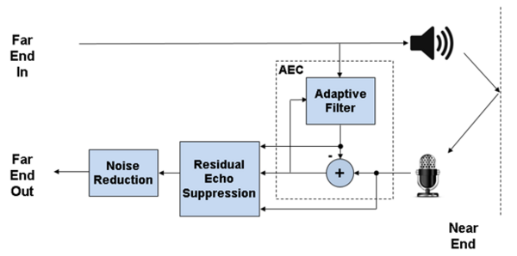
AEC - Acoustic Echo Cancellation

Slide 11
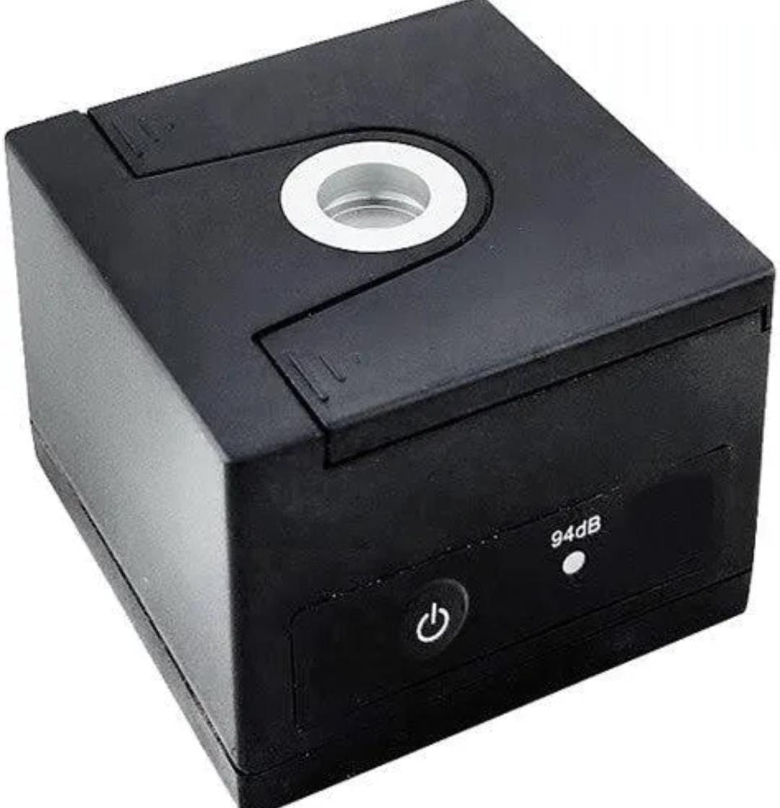
MIC Calibration
Place DUT(94 db) →SET 94DB IN ACQUA →DUT O/P(DB) →ACQUA calibrate

